Slide 1
<html> - Starting Fresh
Unit 12
The Data Bootcamp
Notes:
This week we will learn to build and deploy websites. Before we dive in to coding, we’re going to have a quick overview of some of the technologies we’ll be learning over the next few days and weeks.
What is the Web?

Slide 2

What is the Web?
Notes:
The web is a series of tubes, and they’re full of cats!

Slide 3
What is the Web?
But how do these tubes get filled with cats?
Notes:
But how do these cats get in to these tubes?

Slide 4


What is the Web?
Web developers build them in to a special type of document - a web page.
These web pages are then accessible to other people on the Internet.
(Believe it or not, you can even build web pages with things other
than cats on them.)
Notes:
“Web developers build them into web pages.”
The Web isn’t really a series of tubes, though.
It’s a system of computers that support special types of documents (web pages). Those computers allow other people on the internet to access these documents.
You can request these pages from other people, or create and host your own.
We already know how to request web pages (we use our browser!).
We want to know how to do the second - host our own web pages.

Slide 5
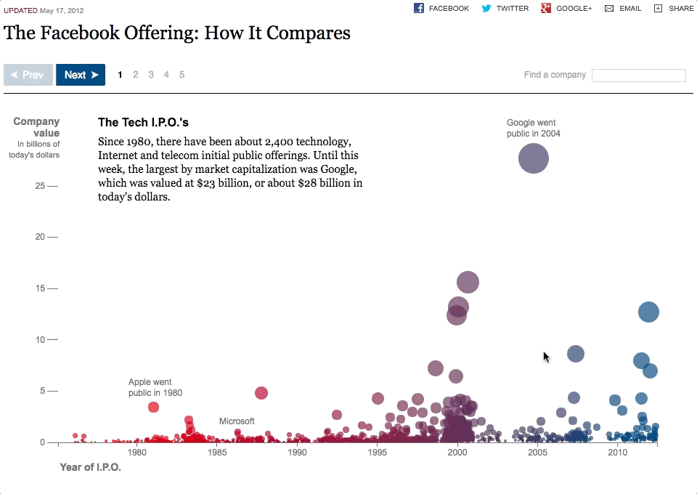
What is the Web?
Data analysts can use the web to tell stories with data, and reach millions of people.
Notes:
Importantly, we can use the web to share insights into data with our users.
Interactive and dynamic charting is very powerful, and can help you do additional analysis on data.
Here we see an example analysis on the Facebook IPO
http://www.nytimes.com/interactive/2012/05/17/business/dealbook/how-the-facebook-offering-compares.html

Slide 6

The Web - Discuss
Discuss with partners!
What are some technologies used in front-end web development?
What can you tell us about each technology, i.e. what is its role in a website?
Notes:
“To know how to build and host these web pages ourselves, we have to understand a few things.”
Have students look up and discuss some front-end web technologies with partners.
After 2 or 3 minutes, have students offer up some of their answers.

Slide 7
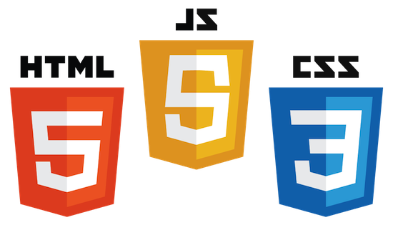
The Core Three Front-End Web Technologies
Notes:
While there are a number of front-end web frameworks and libraries, at the end of they day, we’re using HTML, CSS, and JavaScript to build websites. These technologies are the three pillars of the front end web.
HTML is the important one for today, but we’re going to do a high level overview of CSS and JavaScript as well.
So what is HTML?
HTML is like the body of the webpage, the CSS the makeup and outfit, JS the “brains” or intelligence

Slide 8

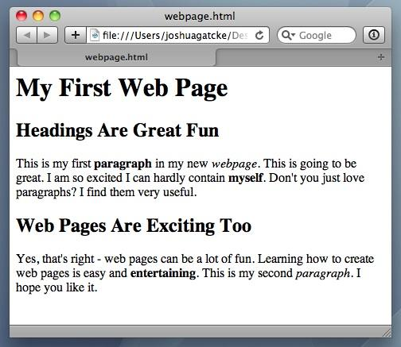
<title> Intro to HTML </title>
HTML is one of the three base languages behind every website.
It defines all of the content of a web page.

Slide 9
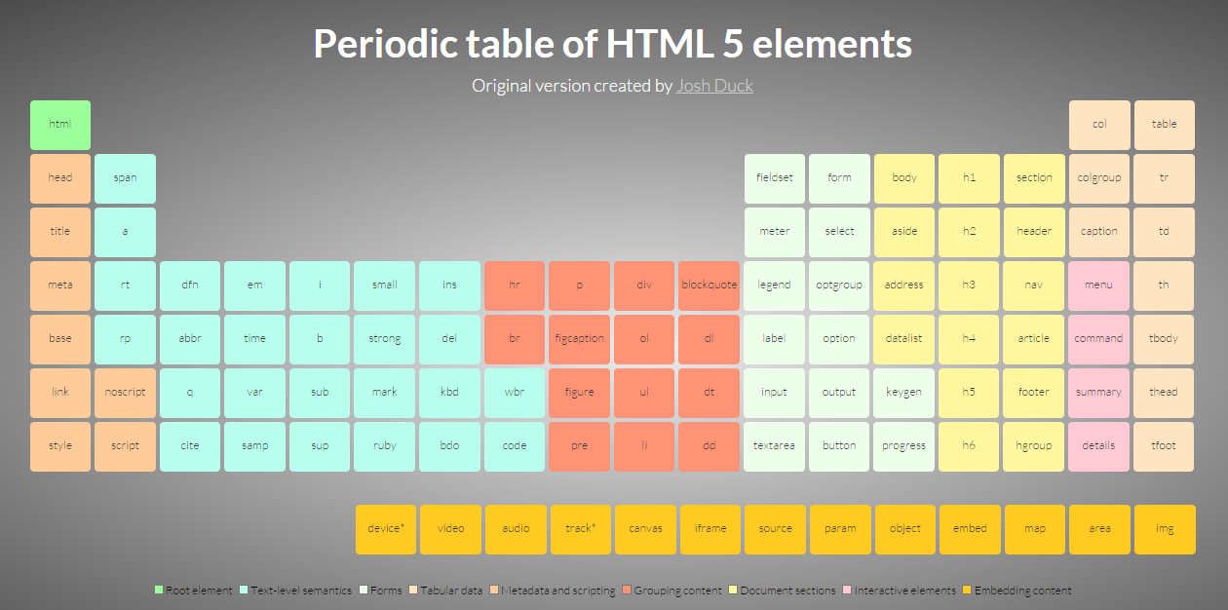
HTML
Stands for “Hypertext Markup Language”. It’s responsible for a page’s content and structure.
Elements are the basic building blocks of web pages.
Notes:
Being a markdown language, HTML doesn’t use variables or loops or functions or have any kind of programming logic.
Instead we use HTML tags to declare what should be rendered to the page in the browser.
There are a lot of different elements!

Slide 10

HTML
HTML elements are rendered by the browser as visible parts of a web page.
Notes:
Being a markdown language, HTML doesn’t use variables or loops or functions or have any kind of programming logic.
Instead we use HTML tags to declare what should be rendered to the page in the browser.

Slide 11
HTML Syntax (Basic)
Content
<h1>
Welcome!!!
</h1>
Opening Tag
Closing Tag
Notes:
HTML tags are written using angle brackets.
*Most* HTML elements follow the format of:
Opening tag
Content
Closing tag
Can students guess what this tag might be used for?
It’s a heading tag. They come in 6 numbered sizes (h1-h6), with h1 having the largest text and being the most important
Heading elements can help describe and section off our content.
Search engines may look at heading tags to try to understand what a web page is about.

Slide 12
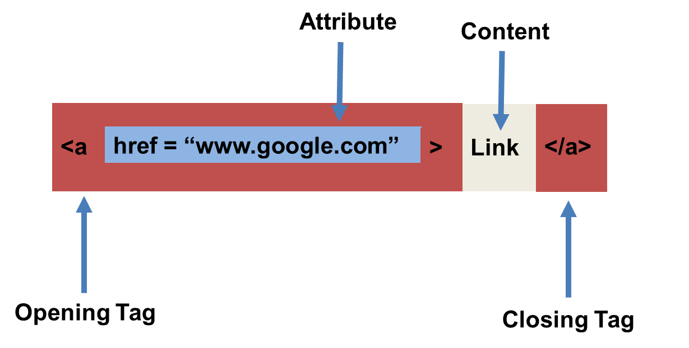
HTML Syntax (with Attribute)
Notes:
Some HTML tags have attributes they are commonly paired with.
An attribute acts as a modifier for an HTML element. They either modify an element’s default behavior, or they can provide functionality to certain elements which are unable to otherwise function without them.
Q: What does this tag look like it’s doing?
In this example, we have an anchor tag, which when rendered to the page creates a hyperlink. The “href” attribute describes the URL that the user should be brought to after clicking the rendered link.

Slide 13
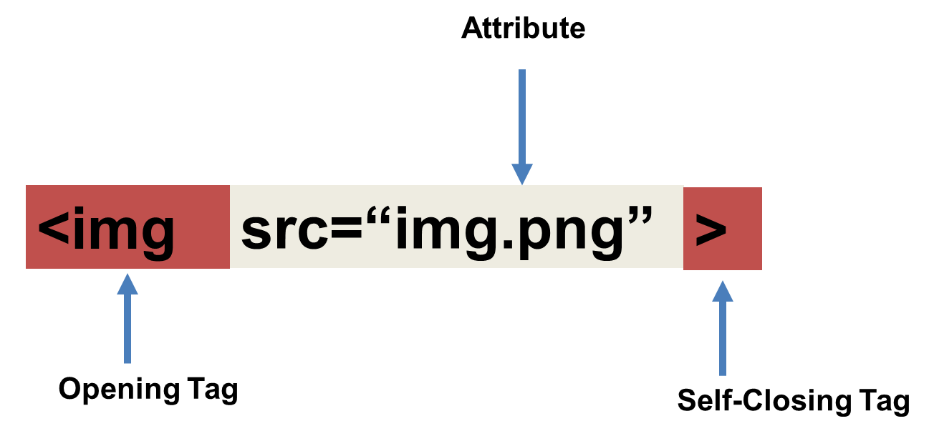
Tricky Tags (Self-Closing)
Notes:
While most elements have an opening and closing tag, a few are self closing. These are known as void elements.
Q: Can you guess what this element is?
An img tag creates an image element, and the src attribute describes the path or URL of the image to display.
We don’t pass any content into an img tag, and it doesn’t need a closing tag.

Slide 14

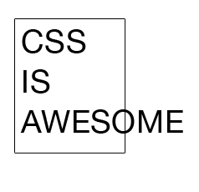
CSS
CSS describes how and where elements should appear on the page.
It defines things such as color, placement, fonts, sizes, and more.

Slide 15
CSS
Stands for “Cascading Style Sheets”.
Responsible for a web page’s presentation.
Describes how each HTML element should appear on the screen. This can be anything from how/where an element is positioned to its size, color, and much more.
CSS is what makes web pages look good.
CSS rules are made up of selectors and declarations.

Slide 16

CSS Syntax
CSS works by adding style declarations to selectors.
If a selector matches any HTML elements, the browser will apply the defined styles to those elements.
Notes:
The selector is how we “select” which elements need to be affected by the CSS declaration.
One type of selector is the element tag name.
Ask students what they think this code might do?
It will give every rendered link on the page a yellow background.
Assure students we’ll cover this in depth tomorrow, so no need to memorize this now or take notes.

Slide 17

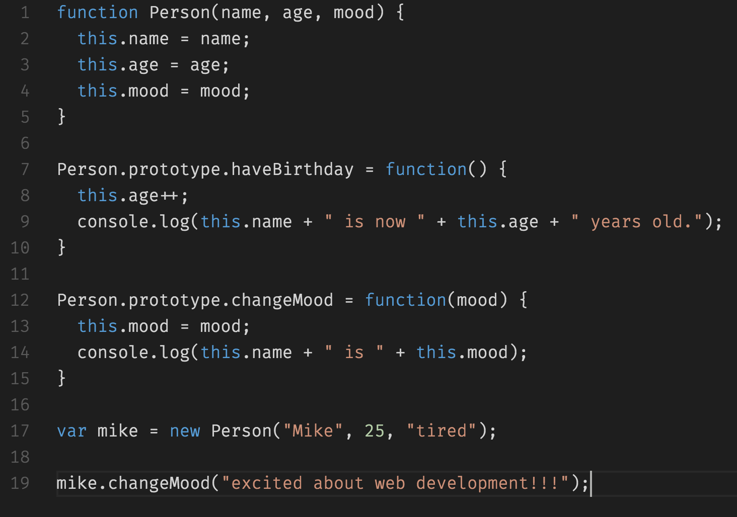
JavaScript
JavaScript is used to handle programming logic and give websites interactivity.

Slide 18
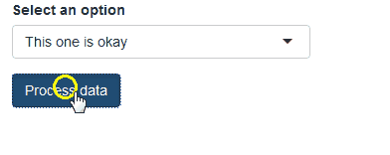
JavaScript
A scripting language created for the front-end web. It’s responsible for a web page’s behavior.
Used to add, remove, or alter HTML elements and their CSS in a web page dynamically.
Handles events such as clicks, key presses, form submissions, and more.
Can be used to perform API requests from the browser.

Slide 19
Over The Next Few Weeks…

Slide 20

All the Technologies!
We Will Cover:
HTML
CSS
Bootstrap CSS
JavaScript
JavaScript Charting Libraries
And more…
Notes:
We have a lot of ground to cover, but students will be capable frontend developers in a few weeks.

Slide 21
Why Do We Need All This?

Slide 22
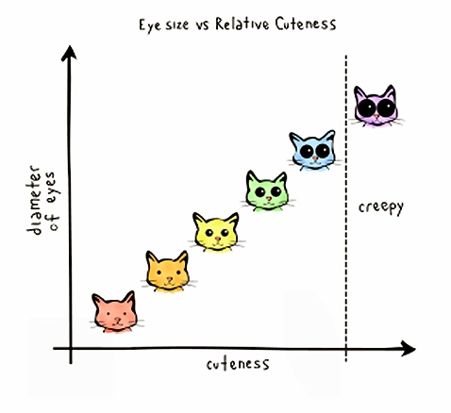
To Visualize Cats!
Notes:
To visualize cats!

Slide 23
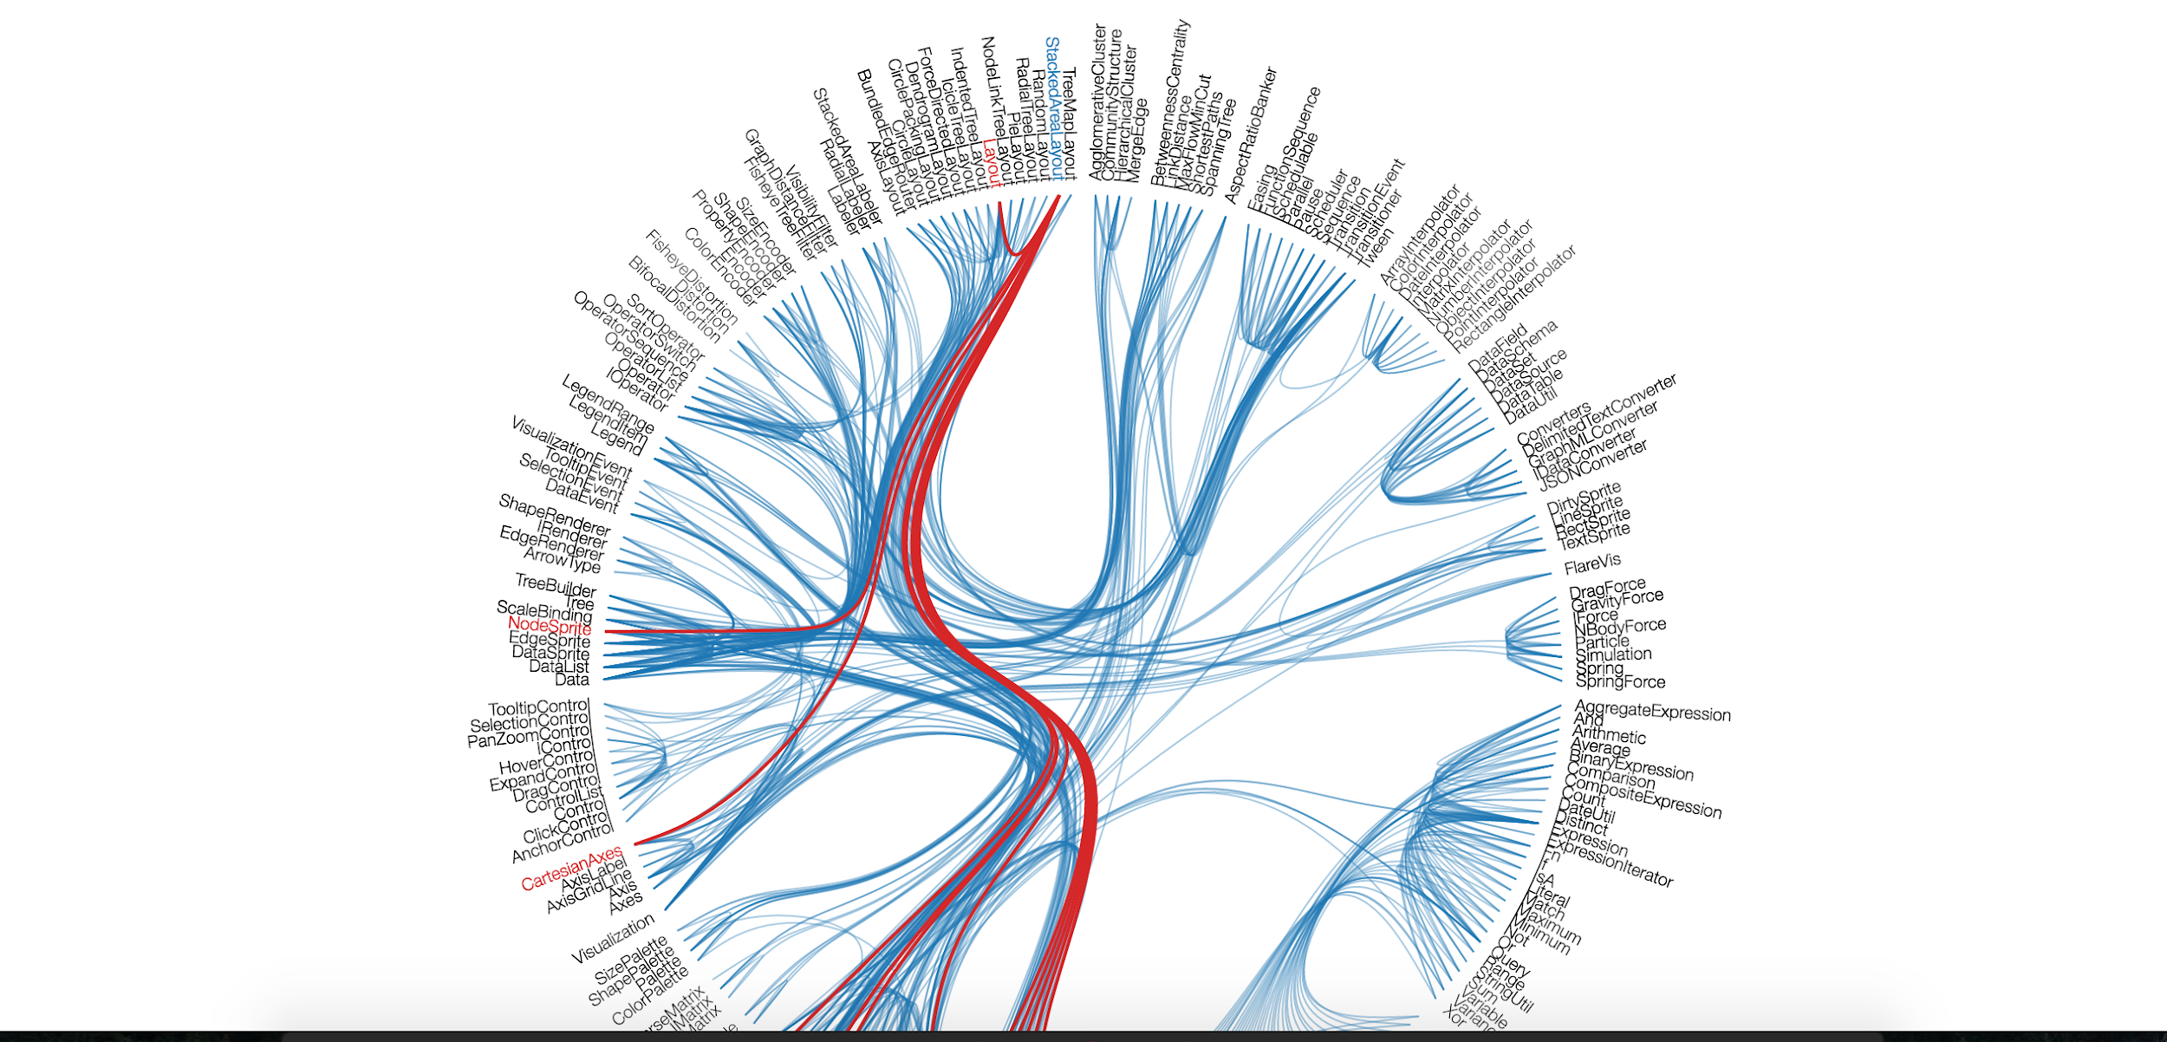
Visualizations (e.g. D3)
We’ll be able to use HTML, CSS, and JavaScript to create some VERY impressive interactive visualizations with big data. View Gallery
Notes:
And to visualize other things too, I suppose…
In order to provide some context as to why we’re learning web development now, show students some of the visualizations that can be created using D3 and other JavaScript charting and mapping libraries
“This opens up whole new possibilities for the types of visualizations we can create with our data.”
Spend a few minutes going through the D3 gallery as a class.
http://d3.artzub.com/wbca/

Slide 24
Now Let’s Get Started!

Slide 25
HTML Syntax Review (Basic)
Content
<h1>
Welcome!!!
</h1>
Opening Tag
Closing Tag
Notes:
HTML tags are written using angle brackets.
*Most* HTML elements follow the format of:
Opening tag
Content
Closing tag
Can students guess what this tag might be used for?
It’s a heading tag. They come in 6 numbered sizes (h1-h6), with h1 having the largest text and being the most important
Heading elements can help describe and section off our content.
Search engines may look at heading tags to try to understand what a web page is about.

Slide 26
HTML Syntax Review (with Attribute)
Notes:
Some HTML tags have attributes they are commonly paired with.
An attribute acts as a modifier for an HTML element. They either modify an element’s default behavior, or they can provide functionality to certain elements which are unable to otherwise function without them.
Q: What does this tag look like it’s doing?
In this example, we have an anchor tag, which when rendered to the page creates a hyperlink. The “href” attribute describes the URL that the user should be brought to after clicking the rendered link.

Slide 27
Tricky Tags Review (Self-Closing)
Notes:
While most elements have an opening and closing tag, a few are self closing. These are known as void elements.
Q: Can you guess what this element is?
An img tag creates an image element, and the src attribute describes the path or URL of the image to display.
We don’t pass any content into an img tag, and it doesn’t need a closing tag.

Slide 28
01-Inst_Basic_HTML_Page (10 mins)
Open up the “index.html” page in your preferred IDE
Should be blank
Together, we will be filling out the content together
Add in a header
Add in an image
Add in links
Ones that open in a new tab
Ones that don’t go anywhere
Ones that open in the current tab
Notes:
<!DOCTYPE html>
<html>
<head>
<meta charset="utf-8" />
</head>
<body>
</body>
</html>

Slide 29
02-Stu_InspectLastActivity (6 mins, Partners)
Open index.html inside the demo folder in Chrome and open Chrome Devtools. You can launch Chrome Devtools by doing any of the following:
Right click the rendered HTML document inside of Chrome and clicking the `inspect` option.
Pressing `F12` on Windows while in Chrome.
Pressing `command + option + i` on a Mac.
Make sure the `Elements` tab is selected.
Study the code here and see how it compares to the actual HTML document
Experiment with modifying the HTML document in your IDE and reloading the web page and inspector.
What happens when you remove an element's closing tag or misspell `head` or `html`?
Notes:
What we see in the elements inspector is what's known as the DOM, or the Document Object Model. This is essentially a tree of objects our web browser uses to model our HTML.
If we were to make a minor mistake in our HTML code, such as spelling the `head` tag as `hea`, we'd probably notice that this would be corrected inside of the element inspector. While Chrome won't change our actual HTML code for us, it will be smart enough to guess what we were trying to do and make sure that's fixed in the DOM.
It's important to note that we shouldn't rely on these corrections. Not all browsers will interpret invalid HTML the same way, so we want to be as accurate as possible to ensure consistent behavior across browsers.

Slide 30
03-Stu_Research_HTML_Tags (8 mins, Partners)
With a partner, research and create a list of different HTML elements and their descriptions.
HTML Tags
?
Notes:
The Google search bar would be an example of an input element
We don’t need to memorize every element, or even use all the semantic HTML elements

Slide 31
03-Stu_Research_HTML_Tags (3 mins, Discussion)
HTML Resources
Mozilla Developer Network - https://developer.mozilla.org/en-US/
Authoritative resource, Complete and accurate information
W3 Schools - https://www.w3schools.com/
Usually the first search result, Simpler diction, Some inaccuracies
HTML5 Doctor - http://html5doctor.com/
Element Index - http://html5doctor.com/element-index/
Look up HTML tags

Slide 32
04-Ins_HTML_Tags (4 mins, Partners)
With a partner, quickly go over the webpage
Open it up in your browser, this is meant to be a informational webpage, not a coding challenge
There are a lot of different HTML tags, but these are the ones you are most likely to use
BONUS: If you have time, you can explore how the page is built
What does &lt; &gt; and &nbsp; mean?
Why are they used instead of the symbols they’re standing in for?
Notes:
`doctype` - tells the browser which version of HTML (or XML) we used to create the document. This isn't really a tag like all the others, but a declaration we put at the top of our page above the rest of the code.
`html` - represents the root (top-level element) of an HTML document. All other elements go inside the `html` element.
`head` - holds elements that provide general information about the HTML document, such as links to external CSS and JavaScript files, the title of the web page, and any other metadata used in the document.
`title` - defines the title of the document as shown in the browser's title bar or on the page tab.
`<meta charset-"utf-8">` - the `meta` tag is used for any other metadata that can't be represented by another HTML element inside the head. In this case, we're specifying that we want to use the "utf-8" character set. This has to do with which language, writing system, and characters being used on a web page. This is currently the most widely used and recommended, as well as one of the most comprehensive.
`body` - represents the content of an HTML document. Any content that needs to be rendered to the page goes inside the body.

Slide 33
05-Stu_MyFirst_HTML (15 mins, Solo)
In a new HTML file, create the basic structure of an HTML document and include in it the following:
DOCTYPE declaration
head tag with nested title tag
h1 tag with a title of your choice
Embed an image
Create the following three links on your page:
One link that leads to the website of your choice. Give this link an attribute `target="_blank"` so that it opens a new tab when clicked.
Create a second link to a different website, but give this link bold text.
Make the third link a placeholder so it goes nowhere.
HINT: You should be checking the rendered HTML in Chrome as you code to make sure you're going in the right direction.
Bonus in README.md
Notes:
The `alt` attribute of an img tag is technically optional, but we should always include it because it’s what search engines, screen readers, and braille displays see.
By default, `target="_self"` is the default attribute for anchor tags (even if we don't write it explicitly). A hyperlink's default behavior is to open the web page in its current tab.

Slide 34
06-Stu_FixThe_HTML (8 mins, Partners)
Open the index.html file inside the Unsolved folder.
This HTML document has several errors. While it may seemingly load in your browser without many issues, this is not valid HTML.
Correct the document and leave a comment above each error describing what you changed.
Refer to the Mozilla HTML Documentation to research any unfamiliar HTML tags.
Link in readme

Slide 35
06-Stu_FixThe_HTML (5 mins, Discussion)
The W3 Schools’ Validator is a resource for validating HTML
https://validator.w3.org/#validate_by_input
Browsers focus more on the experience so they will try their best to smooth out any errors
This provides a better user experience, but makes debugging a little harder
Each browser might handle errors differently, this leads to erratic behavior
Error messages are our friend
The validator looks for errors in your HTML
Not perfect, but it’s a good tool if you’re stuck

Slide 36
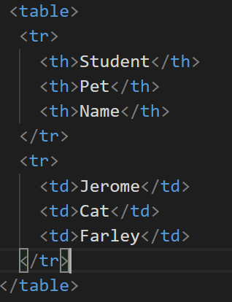
07-Ins_WorkingWithTables (5 mins, Discussion)
Wrap the entire table in an opening and closing table tag
Use the tr tag to indicate a new table row
the th tags are used to declare the headers of the table
for each th tag, subsequent rows should have a td tag to add table data
Notes:
* **table:** Acts as a container for our rows and columns.
* **tr (Table Row):** These elements serve as rows for our table. They contain a row of table cells.
* **th (Table Header):** These are table cells that are for containing column titles. These will have bold text by default.
* **td (Table Data):** These are table cells for holding data. These are not column titles.
* We also have a few other optional table tags that can be used to give semantic meaning to our table. These include:
* **thead (Table Head):** Acts as a container for the row(s) holding our table headers.
* **tbody (Table Body):** Acts as a container for the rows holding our table data that is not part of the table head.
* **tfoot (Table Footer):** Acts as a container for bottom rows in a table which acts as a summary of the tables content. The `tfoot` element is rendered at the bottom of the table by default, regardless of which row(s) it's holding.

Slide 37
07-Stu_WorkingWithTables (15 mins)
Open the Resources folder. Here we have a relatively simple spreadsheet.
Create a new HTML document and create a table to represent the data in the spreadsheet.
Refer back to 04-Ins_HTML_Tags
Try to get the formatting as close to the spreadsheet as possible.
Bonus: Use table colspan and border attributes to make the table look even more similar to the spreadsheet.
Group the completed table using a thead, a tbody, and a tfoot element.
Notes:
we can achieve the effect of bold text here by using `th` elements for our headers. We could technically use strong tags, but since we have elements already made for this specific purpose, it's better to use those instead.
we can increase the width of a td or th element by using the colspan property
the border property. Explain that this gives our table a border we can adjust the thickness of by increasing its value. We'll learn more advanced ways of doing this with CSS, but this is fine for now
the use of the thead, tbody, and tfoot elements. Explain that we can make a valid HTML table without these, but we add semantic meaning to the content inside of our table if we do, so we should try to whenever possible.
it would probably take them a long time to insert more than just a few rows from a spreadsheet or database into an HTML document in this way. It's important to become familiar with how different elements work together, but assure students that we're going to learn better, more programmatic methods of rendering HTML populated with external data. More on this next week!

Slide 38
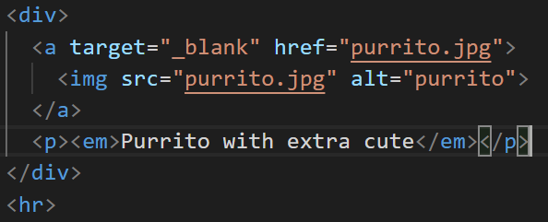
HTML Images and Links (8 mins, Discussion)
An anchor tag is a link.
The href is the address the link takes you to
The target is where to open the link
Default is the same window
You can put anything between the opening and closing a tags, including images or even complete divs
divs are used to separate your HTML into different sections, much like Jupyter Notebook Cells are used to separate your python code

Slide 39
10-Stu_ImageAndLinks (15 mins)
Create a new project folder. Inside, create a new HTML file and name it index.html. Fill this document in with a basic HTML skeleton.
Launch Jupyter Notebook, and open any previous project created using matplotlib. Download all images of graphs created with pyplot to your local project folder.
At the top of the HTML page, add a h1 tag containing the name of your chosen project.
For each downloaded image, add one image element to your index.html file. Set the src attribute of each image to the path to a different image in your project folder. Be sure to add a description for each image in the alt attribute.
Add a horizontal rule between each image.
Underneath each image, add a description of its graph in italicized text using the em element.
Add functionality so that when an image is clicked, it will open a new tab to that image's URL.
Notes:
we can make the images clickable links by wrapping them in anchor tags. Instead of inserting text inside of anchor tags to be displayed as a hyperlink, we used an image instead.
`article` and `section` tags - relatively new semantic elements we can use to group our content into related sections. These are optional, but it can help to organize our HTML into different parts
the `div` element can also be used to divide content and behaves the same way the `article` and `section` elements do when rendered to the page. The `div` tag, however, doesn't have any semantic meaning
we can make text italicized by using the `<em>` element. In additional to making text italicized, the `<em>` element has a semantic meaning as it marks text which has stress emphasis
`figure` and `figcaption` as a more semantic approach for these figures than articles
The `figure` element is intended to be used in conjunction with the `figcaption` element to mark up diagrams, illustrations, photos, and code examples (among other things)

